Slide 1
LNHS PTSA Wednesday February 15, 2023 6:30pm General Meeting
Followed By
VALENCIA DUAL ENROLLMENT INFO SESSION
Q&A with Valencia College DE Coordinators

Slide 2
LNHS PTSA Meeting Agenda February 15, 2023
Agenda:
Welcome/Confirm Quorum/FB Live Attendees
Meeting Called to Order by President
Introductions/Special Guests
Position Board Members
President Christal Feldman
1st VP - Membership Brenda Meadows
Treasurer Michelle Adamick
Recording Secretary Gabriella Nguyen
Corresponding Secretary Sophia Rogers
Chairs
LWL Advisors Suzanne Arnold/Tania Abreu
Finance Gita Raghoonandan
Staff Appreciation Angie Garcia/Hannah Howell
Legacy Bricks Dierdre Smith
Web Master Erika Remley
Staff Liaison Kari Grimm
OLD BUSINESS
Approval of Past Minutes (January)
Review of January Financial Report
NEW BUSINESS
Membership Updates
Spirit Wear Sales
Legacy Brick Campaign
Amazon Smile
Staff Appreciation
Senior Scholarships
2023-2024 Board Application
Communication Updates/Announcements
Next General Meeting - Wednesday, 4/26 at 6:30pm
Meeting Adjourned by President
February Meeting Topic: Valencia College Dual Enrollment - Q&A with Coordinators

Slide 3
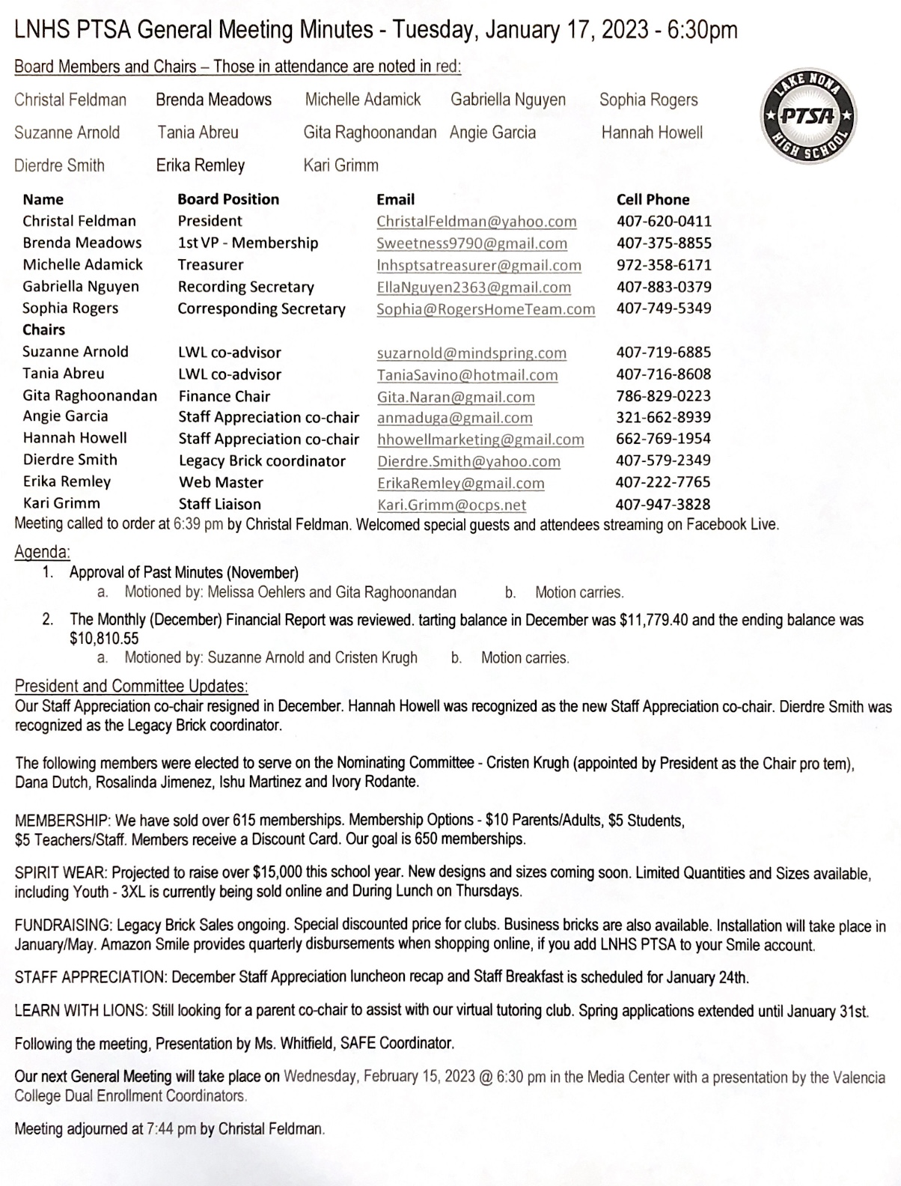
PAST MINUTES FOR APPROVAL January 17, 2023

Slide 4
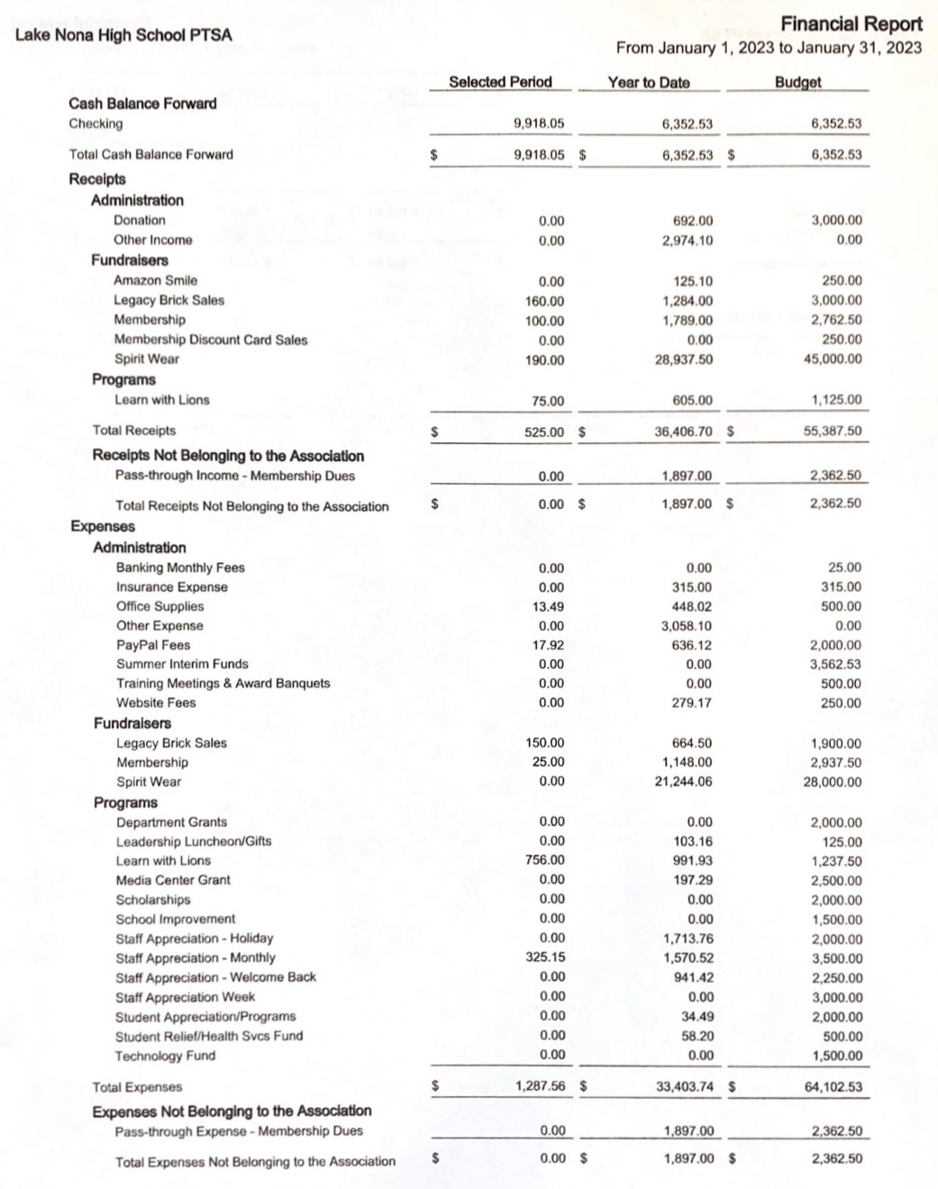
FINANCIAL REPORT FOR APPROVAL January 2023 Financial Report
Year to Date Summary January Beginning Balance - $9,918.05
January Ending Balance - $9,155.49

Slide 5
PTSA MEMBERSHIP - Currently Over 660 Memberships Received - Our Goal was 650 Memberships Membership Options Parent/Adult - $10 Teachers & Staff - $5 Students - $5 (Includes Discount Card)

Slide 6
SPIRIT WEAR - Limited Quantities and Sizes Available (Youth up to 3XL) - Spirit Store On Campus (Thursdays During Lunch)
Pre-orders will Arrive in March

Slide 7
LEGACY
BRICK SALES - Great Gift for Seniors & Alumni
- Special Pricing for Clubs
Business Bricks Available
Deadline in April for May Installation

Slide 8
Add Lake Nona High School
to Your Amazon Account
while shopping ONLINE!
(Program ending by February 20th.)
www.smile.amazon.com

Slide 9
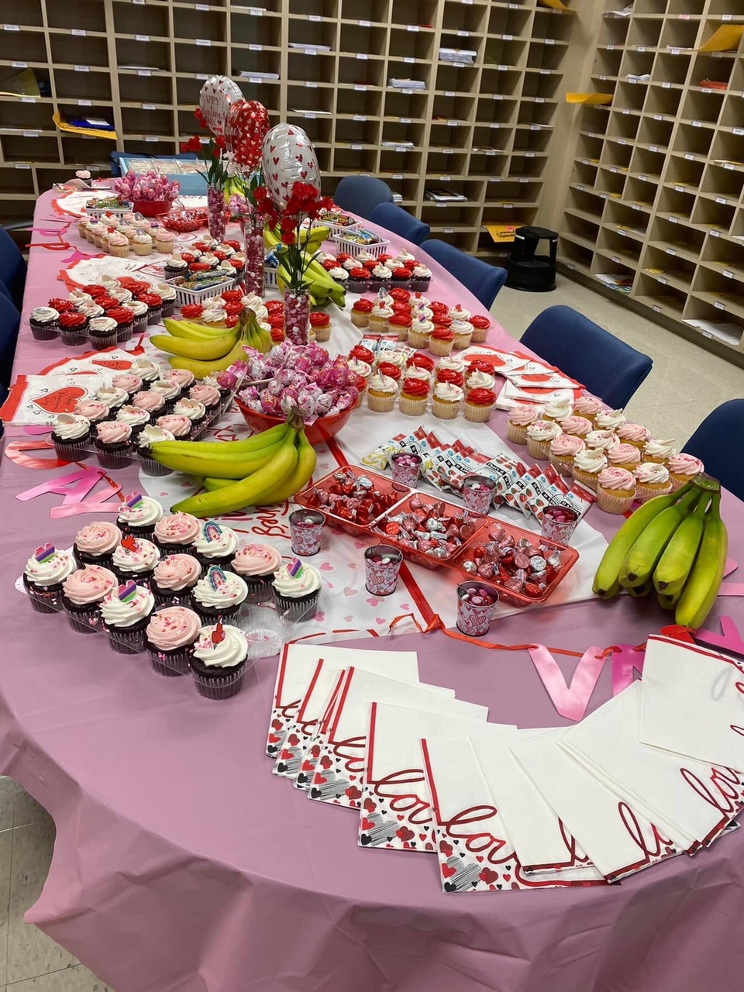
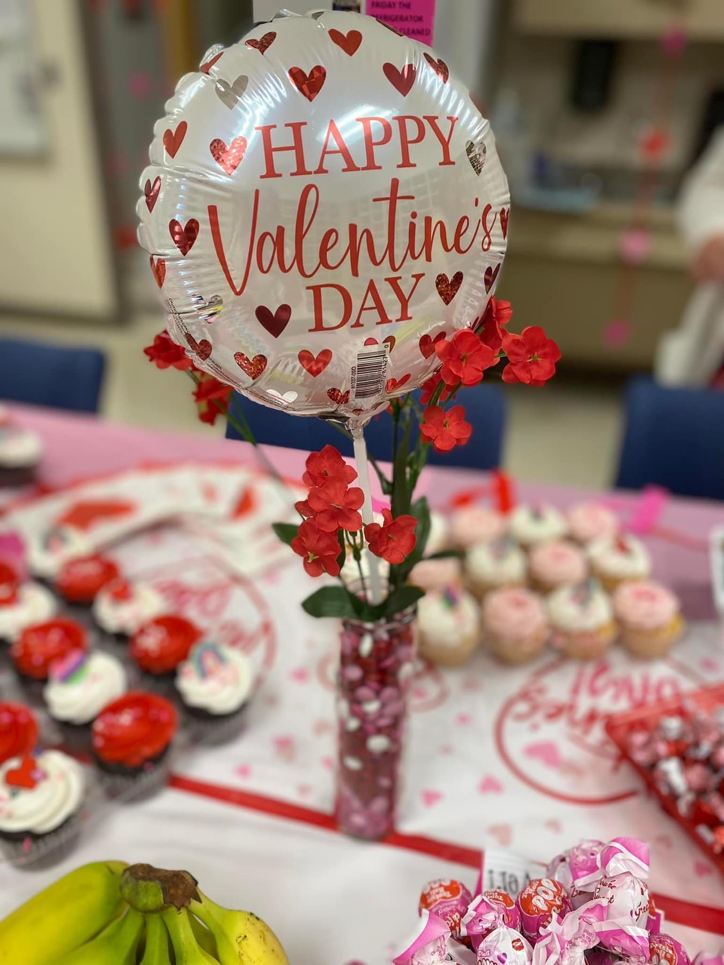
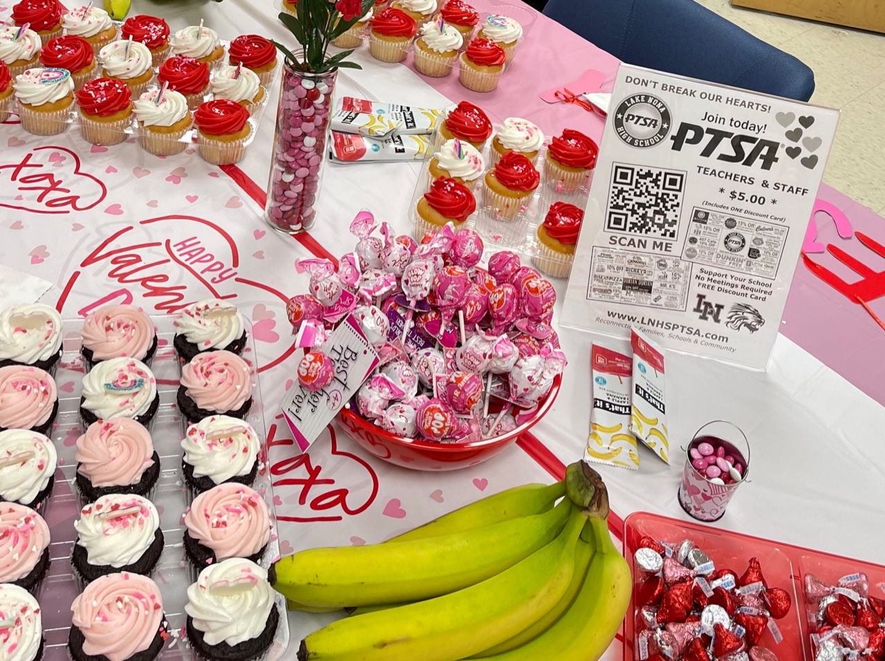
Valentine’s Day February 14th
STAFF
APPRECIATION
Staff Breakfast
January 24th

Slide 10
SENIOR SCHOLARSHIPS
Attention High School Seniors…
Apply now to be considered for a Florida PTA Scholarship.
Submissions will be accepted until Wednesday, March 22, 2023.
Applicant must be a PTSA member for at least 30 days before submission.
www.FloridaPTA.org/Scholarships
There are scholarships, not only for University/Community College, but also for Technical
and Fine Arts schools!
Stay tuned for local scholarship opportunities from OCCPTA and LNHS PTSA coming soon.

Slide 11
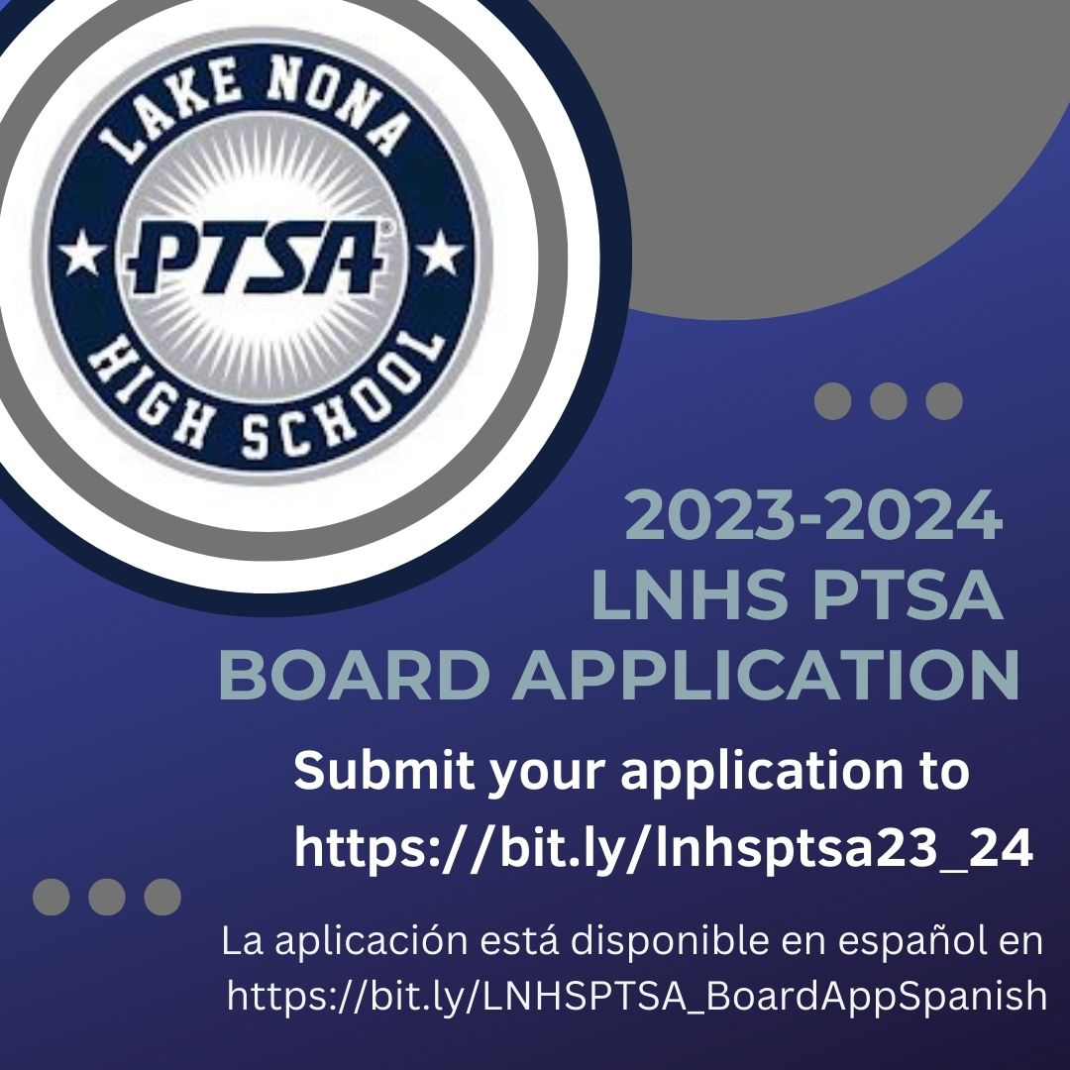
Our Nominating Committee is seeking candidates for the 2023-2024 LNHS PTSA Board.
If you are interested in one of the following PTSA Board positions, please complete the application by Friday, March 3, 2023.
The application is also available in Spanish.
President
Vice President
Treasurer
Recording Secretary (Student Position)
Corresponding Secretary
After completing the google form, you will be contacted to schedule an interview.
For more information, please visit www.LNHSPTSA.com.
Board Elections will take place at the General Meeting on Wednesday, April 26th at 6:30pm.
You MUST BE A LNHS PTSA MEMBER
(for at least 30 days) to vote in April.

Slide 12
PTSA STAFF APPRECIATION

Slide 13
STAY CONNECTED
WITH LNHS PTSA
www.LNHSPTSA.com
www.Facebook.com/LNHSPTSA
SAVE THE DATE
Next General Meeting - Board Elections
April 26th at 6:30pm
(Wednesday)

Slide 14
LNHS PTSA February Meeting Topic
VALENCIA COLLEGE DUAL ENROLLMENT
Info Session and Q&A with Valencia College DE Coordinators

